Slide 1

Data Analysis Report
For Google Merchandise Store
Dimitrios Patramanis • Dimitrios – Paraskevas Tagkoulis • Evgenia Papageorgiou • Melpomeni Tzioli

Slide 2
Analysis Process
KPI’s & Metrics
Normality & Significance Testing
Findings & Proposals
Definition of basic set of metrics to create an analysis report
Testing the datasets from our previous report
For optimizing SEO & e-shop’s interface
Metrics Report
Hypotheses & Results
Visualization of basic metrics
Correlation Analysis & Interpretation

Slide 3
KPI’s & Metrics
Number of Visitors
Sessions
Unique & Returning Visitors
Visitors’ Location
Visitors’ Demographics
Users by Browsers & Devices
Landing Pages
Exit Pages
Frequently visited pages
Session Duration by Users
Pages per Session
Bounce Rate
Avg Page Load Time
Page Views
Conversion Rate

Slide 4
A. Metrics Report Jan-Mar 2018-2019
What is our Audience?
Do we have visitors who return to our site?
What is our demographics’ distribution?
Is our website interesting enough for our users?
Do we have any insights regarding browsers? May they have any issues?
How is the website traffic developing?
What is the website’s organic traffic?
What is our pages speed?
How much time do our visitors spend in our pages?
How many pages are being visited?
What is our conversion rate? Do visitors get what they need?
Notes:
Our metrics report consists of dashboards that answer the following questions.

Slide 5

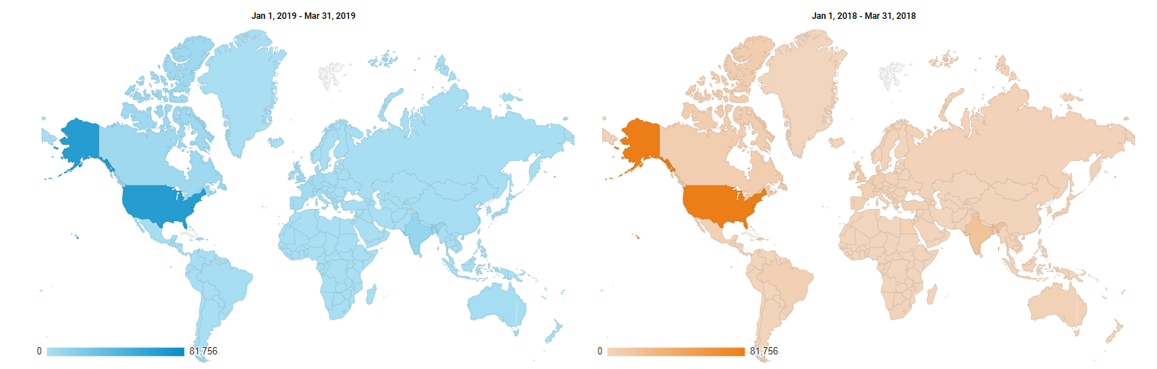
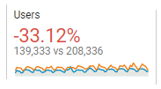
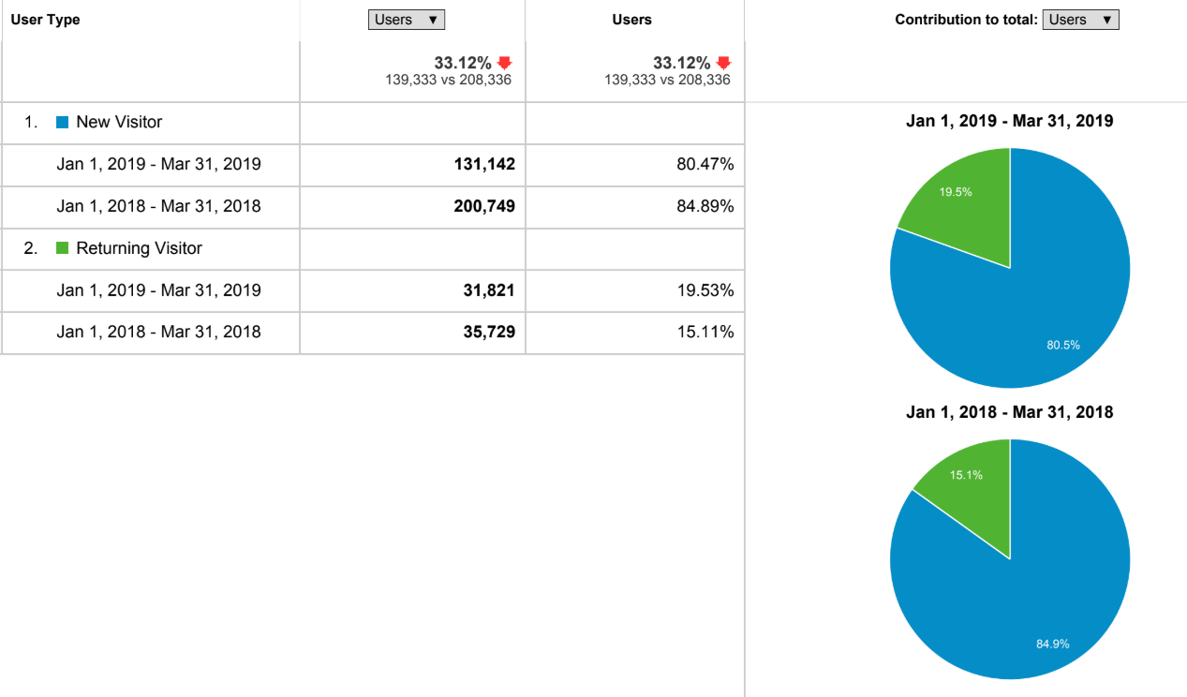
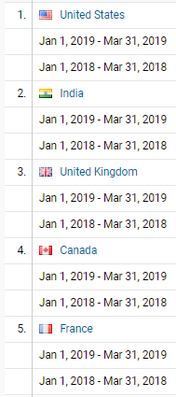
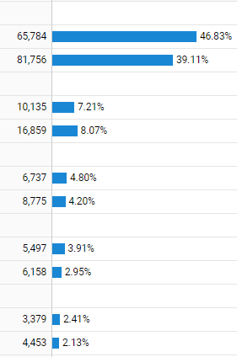
What is our Audience?
Number of visits
Number of unique and returning visitors
Audience mainly from US →
Focus 80% of advertising efforts & budget / rest on exploring different audiences.
Fall in 2019 →
Assumption: Visitors found website not interesting enough to visit again in a years’ time.
1st 2019 & 2nd 2018

Slide 6
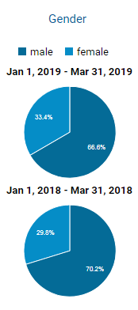
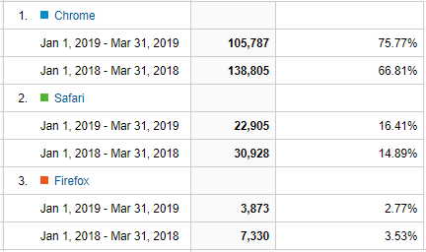
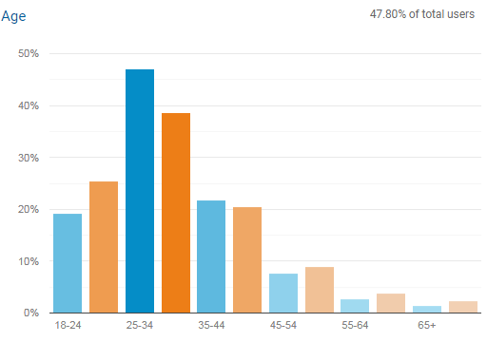
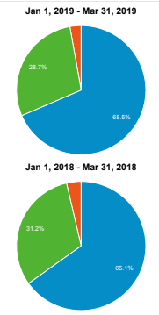
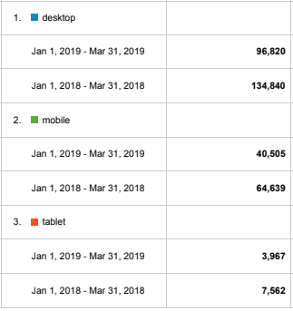
What is our Audience?
Browsers & access device
Other demographic data (age, gender)
1st 2019 & 2nd 2018
Notes:
Here we see that there is a reduction in both male & female audience. Also, the age-team that has mostly face such a decrease is the users between 18-24, so we estimate that this may be due decrease in mobile use & it is an issue that should be examined to understand how mobile friendly is the site and what moves should be done for its improvement.
From the other side we observe that there is almost a 10% raise in the people between 25-34.
As for browsers & devices metrics we observe that the most leading browser is chrome & leading device the desktop.

Slide 7
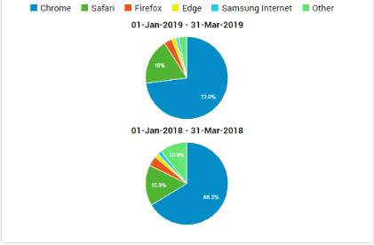
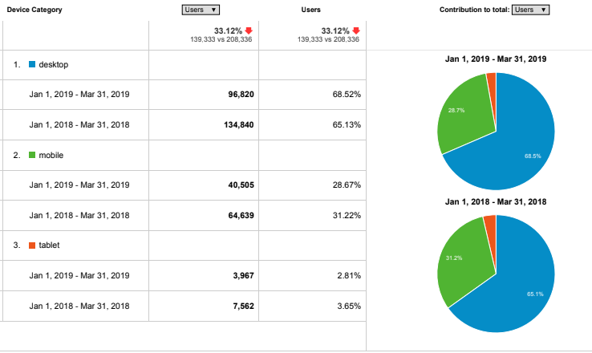

What Devices are used?
Do we have any insights regarding browsers?
Most people use desktops to insert to our site.
The mobile users have been reduced.
Chrome > Bounce Rate
Almost equals to unit. Close to ideal.
Bigger rate = no conversions in one session.
Best case scenario: one user converts in a session.
1st 2019 & 2nd 2018
Notes:
Chrome has the most bounce rate among the other browsers.
Users by Sessions: Ideally, this metric should be as close as it can to a unit. The bigger rate may mean that no conversions are completed throughout one session. The best case is that one user would convert in one session.
This metric shows close to this thought, so It’s close to ideal.

Slide 8
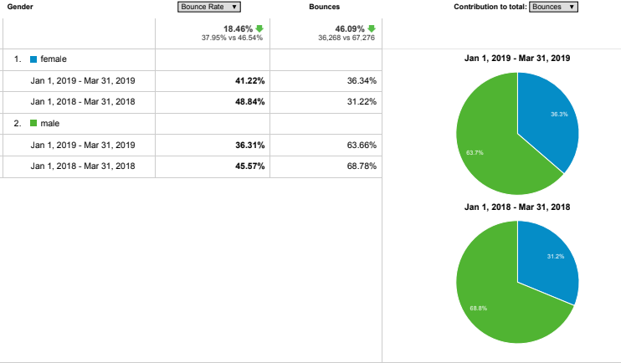

Are the users requirements being met?
Is our website interesting enough for our users?
Bounce rate ↓ between years
√ has already been improved
√ continue reduction to keep our customers occupied with our site for as long as it needs to finally make conversions.
Aiming at making it lower than 40%.
Males / Females – Bounce Rate
1st 2019 & 2nd 2018

Slide 9
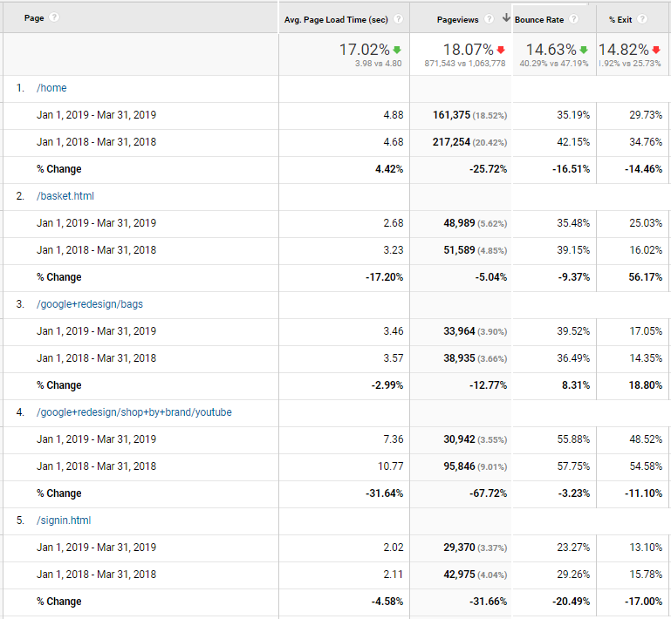
What is our pages speed?
All pages →
big page load time →
↑ abandonment rate →
solution to reduce this delay.
1st 2019 & 2nd 2018

Slide 10
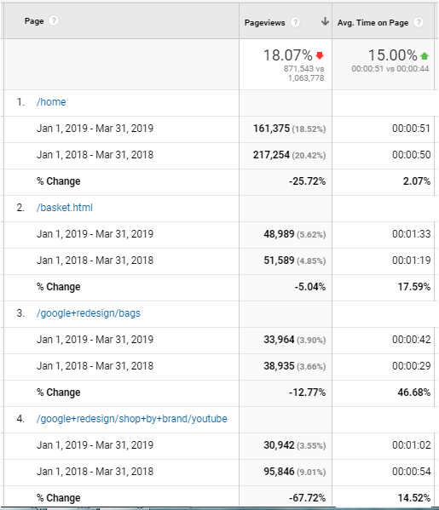

How much time do visitors spend on a page?
Most viewed pages →
Avg time = a minute
Focus on more exposure time on our pages
↑
1st 2019 & 2nd 2018
Notes:
For Number of Pages per visit (pages/session) an outcome would be that users who enter our website may be more interested/engaged in our products than them of the previous year. Or that our site is a little bit more optimized, or have inserted some popular products that made people search for them in the website.

Slide 11
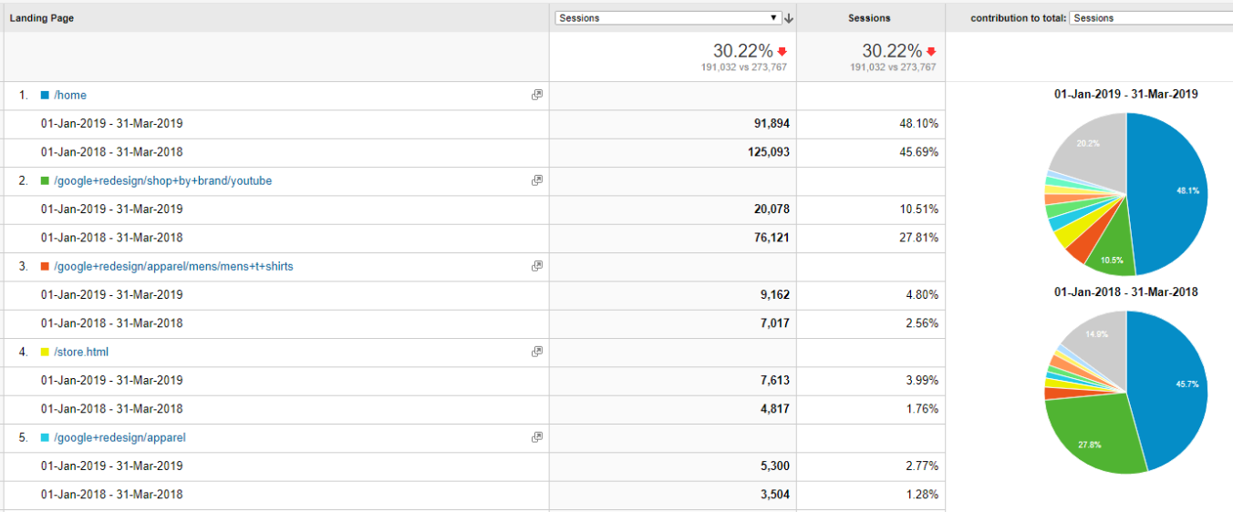
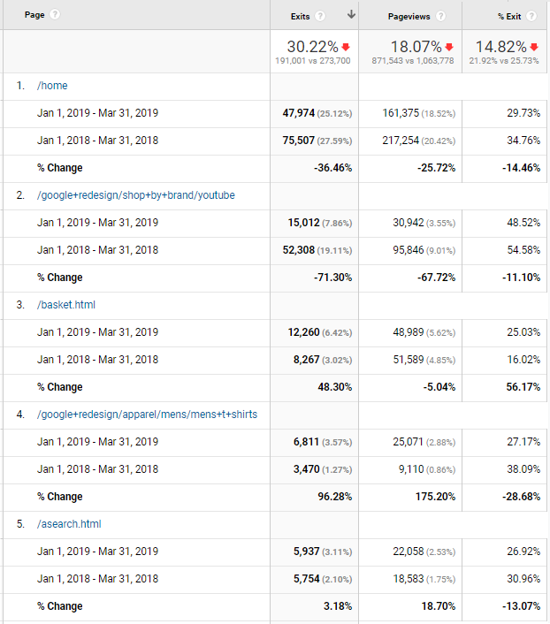
Common landing pages
Home page → 1st landing page
√ keep it friendly
√ decrease its loading time
Common exit pages
Home page → 1st exit page
Users psychology
/google+redesign/shop+by+brand/youtube → searchers leave this page – so interesting content may be missing → need of new content/products or page / interface optimization
1st 2019 & 2nd 2018

Slide 12
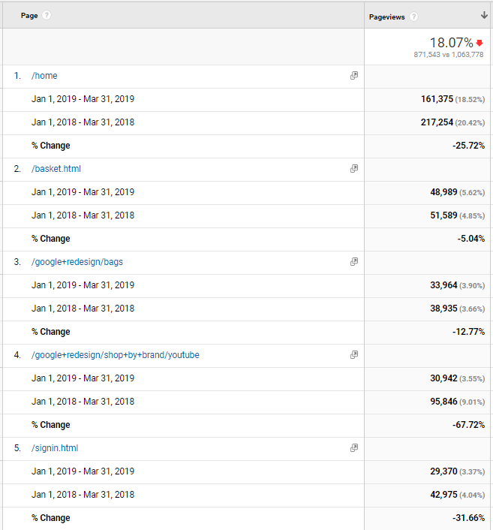
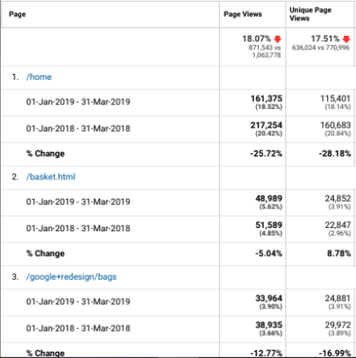
Frequently visited pages
Page Views
Observation: We can see a decrease in views of most popular pages → optimize home, cart & add some more modes of payment in the relevant page.
→ optimize frequent pages interface
Observation: Home page views ↓
→ use of targeted keywords to optimize this metric.

Slide 13
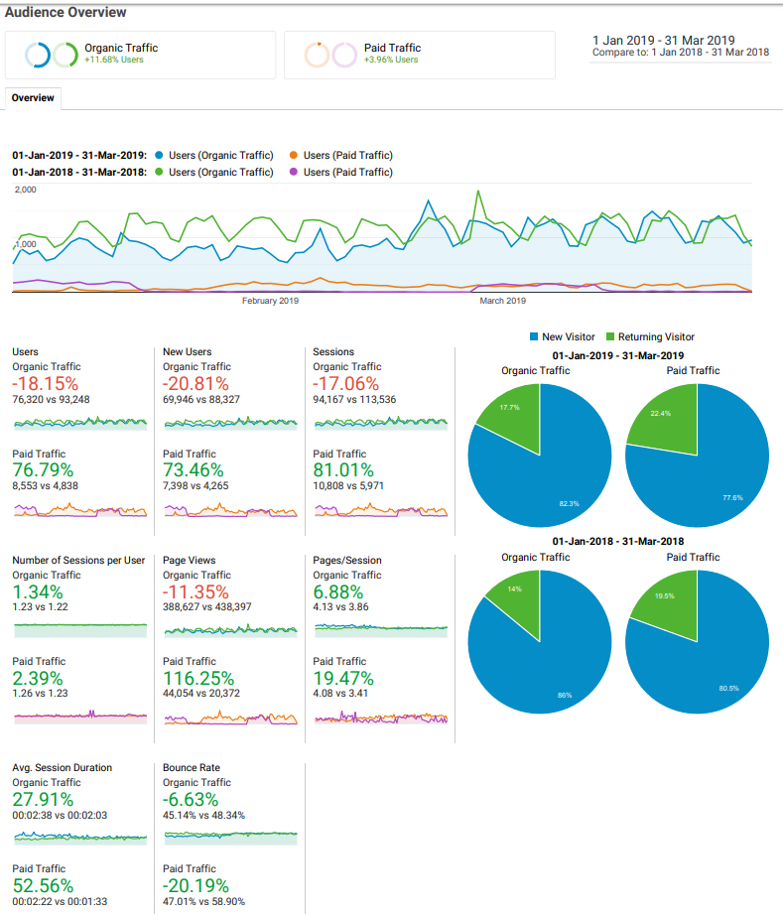
Organic vs. paid traffic
Organic traffic →
a lot higher than paid traffic
Organic Traffic →
Increases number of New Users
Organic Traffic 2019 ↓
Paid Traffic 2019 ↑

Slide 14
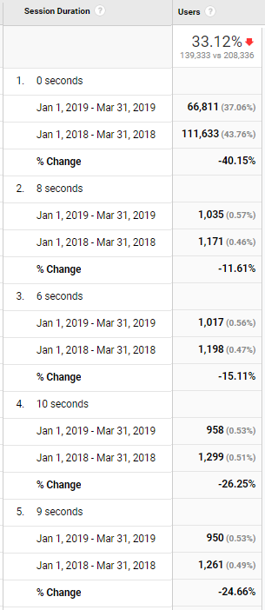
Session Duration by Users
Most of visitors spend only a few seconds or bounce.
May mean that users that reach us don’t find any interest in our website
1st 2019 & 2nd 2018
Notes:
How much time do our visitors spend in our pages? Do we have quality in our website?

Slide 15
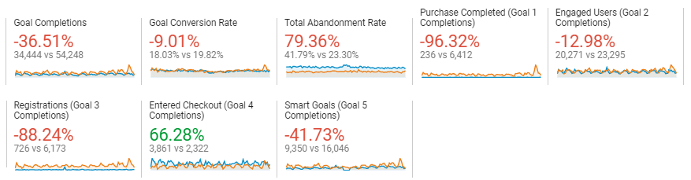
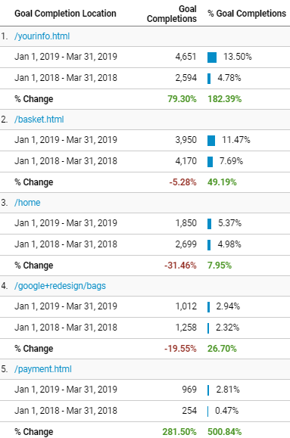
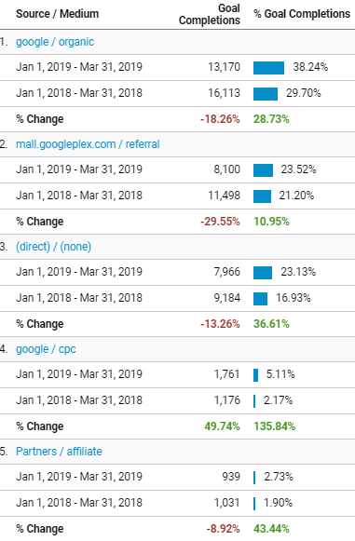
What is our conversion rate?
The bigger the better.
The general picture → pages already returning conversion rates in 2018, these also produced conversions in 2019, in a little bit higher rate.
In general ↓ in number of completions → measure for action should be taken.
(conversion rate optimization strategy, optimize our mediums to complete conversions, test our site step-by-step, optimize its design, SEO, examine the offers, campaigns, offer guarantee on some products, provide high speed)
Google & other referrals → mediums we should mostly focus on to take actions & gain visits & conversions.
https://www.spinutech.com/webres/Image/digital-marketing/articles/7-website-analytics-that-matter-most-infographic.png
1st 2019 & 2nd 2018
Notes:
Do visitors perform desired target actions?

Slide 16
B. Correlation & Significance Testing
Test Name | Tested Variables |  | Result
Bounce Rate 2018 vs 2019 | 2018 Bounce Rate | 2019 Bounce Rate | Significant
Female Vs Male Revenue | Female Revenue | Male Revenue | Not Significant
Gender Bounce Rate | Female Bounce Rate | Male Bounce Rate | Significant
Gender Conversion Rate | Female Conversion Rate | Male Conversion Rate | Not significant
Gender Users | Female Users | Male Users | Significant
New Vs Returning Sessions | New User Sessions | Returning User Sessions | Significant
New Vs Returning Users Avg Session Duration | New User Avg Session Duration | Returning User Avg Session Duration | Significant
New Vs Returning Users Bounce | New Users Bounce Rate | Returning Users Bounce Rate | Significant
New Vs Returning Users Revenue | New Users Revenue | Returning Users Revenue | Not significant
Organic vs Paid Session Duration | Organic Session Duration | Paid Session Duration | Significant
Page views 2018 vs 2019 | Page views 2018 | Page views 2019 | Significant
Site Speed 2018 vs 2019 | Avg. Page Load Time (sec) 2018 | Avg. Page Load Time (sec) 2019 | Significant
Users 2018 vs 2019 | Users 2018 | Users 2018 | Significant
Notes:
after choosing the datasets we wanted to examine, we carried out normality testing to understand if we deal with normal data distribution or not. This indication assisted to opt the testing method for our next step. Namely, we choose between non-parametric analyses methods or parametric. …
Conducting significance testing we Measure the strength of evidence that our data sample supplies for or against null hypothesis.
In this table there wasn’t even one pair of variables that was normally distributed. So, in every single case, we used non parametric method and specifically Wilcoxon-Mann-Whitney, because we were always testing two groups of variables.
(If p value < a =0,05 then the null Hypothesis (H0 >homogeneity) is rejected → this means a statistically high significance)

Slide 17
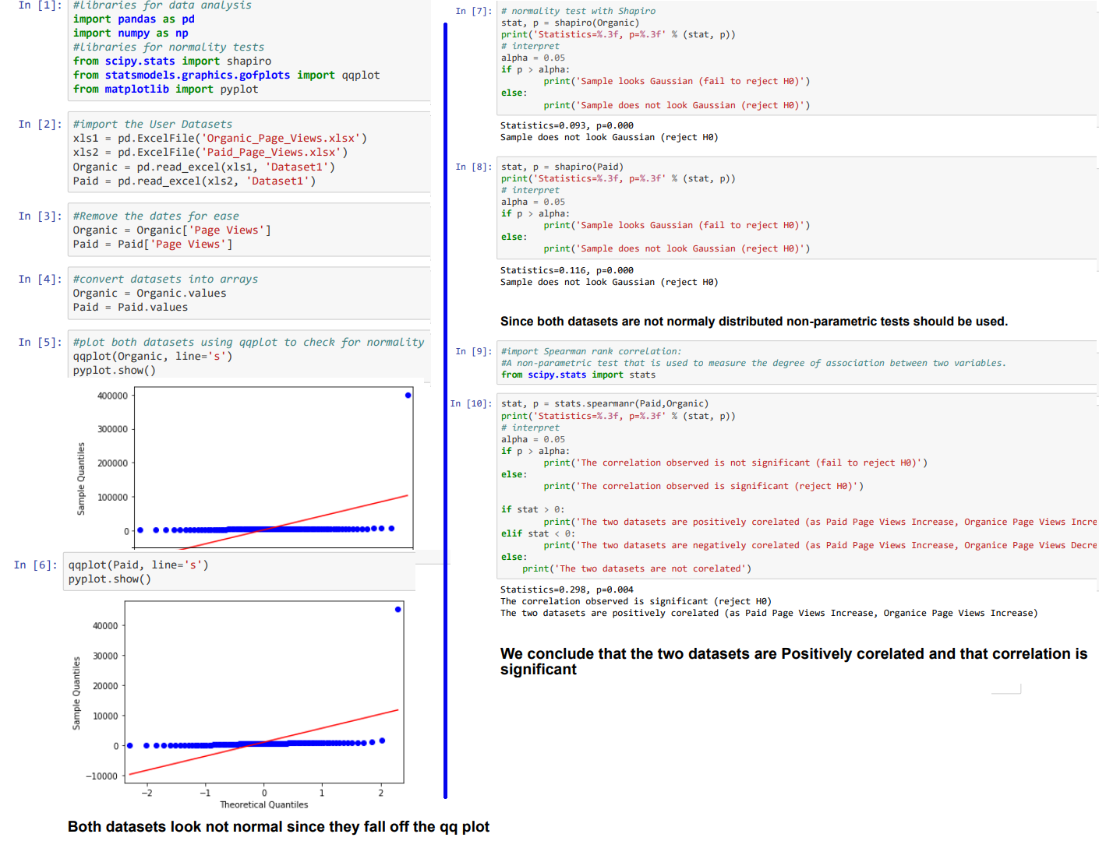
Hypothesis
1
Organic Views are not related
to Paid.
Why? → Do visitors coming from a search engine have any correlation with paid page views?
Positively related:
Paid Page Views ↑
Organic Page Views↑
Notes:
we used our observations from our previous metrics to define correlations of data that are interesting to be examined

Slide 18
Proposals Hypothesis 1
Bidding on search queries can affect the broader market around those searches by shifting searcher demand, incentivizing (or de-incentivizing) content creation, etc
Make some crucial paid keywords
Keyword phrases &
Optimize general SEO ads to generate also organic traffic.
Searchers more likely to click an organic listing
Paid results do strongly impact organic click-through rate, especially in certain queries or
Paid ad clicks may lead to increased links, mentions, coverage, sharing, etc. that can boost organic rankings
Correlation Coefficient 0,298
Paid Page Views ↑
Organic Page Views↑

Slide 19
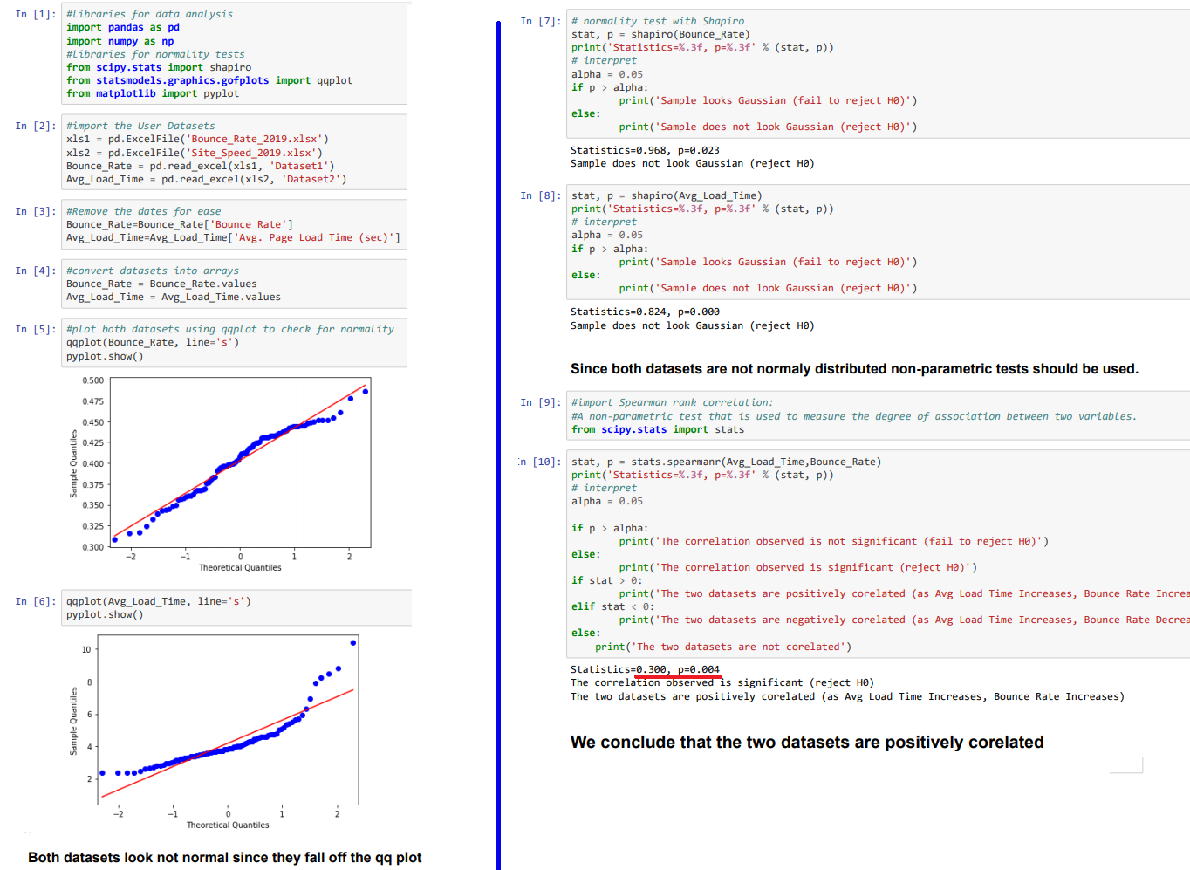
Hypothesis 2
Site Speed is not related to Bounce Rate.
Why? → check if any change in average load time in e-shop’s pages is translated in increase / decrease of bounce rate?

Slide 20
Proposal Hypothesis 2
Correlation Coefficient 0.300
Avg Load Time ↑
Bounce Rate slight ↑
Focus on each browser
& optimize device individually to reduce Avg. Load time.
This will assist in lowering simultaneously the bounce rate.

Slide 21
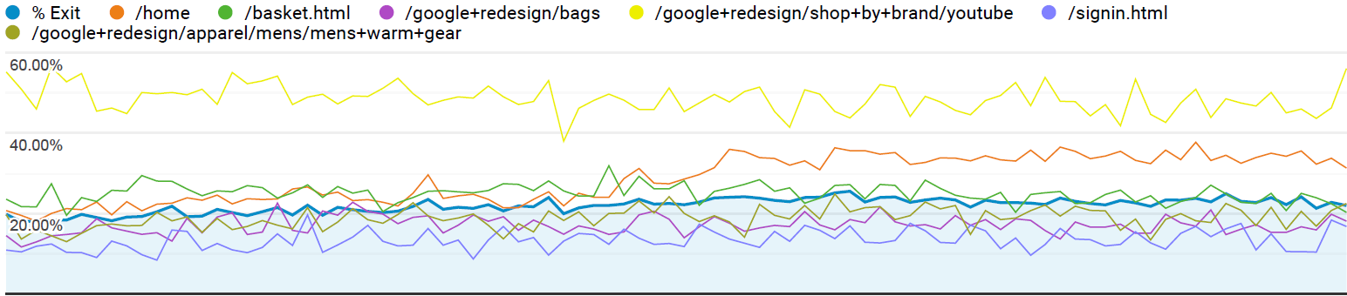
Hypothesis 3
% of Exit is not differing from page to page.
Why? → This can be used to see if our users leave our site from different than expected pages (i.e not home, basket, checkout, thank you page).

Slide 22
Proposal Hypothesis 3
We checked the differences in percentages & results are statistically significant. In particular /google+redesign/shop+by+brand/youtube → most frequent exit page which is unexpected.
Ιnvestigate this page’s UI and UX elements as well as the products offered in that page to identify what is pushing users away from this particular page.
Results / Proposals

Slide 23
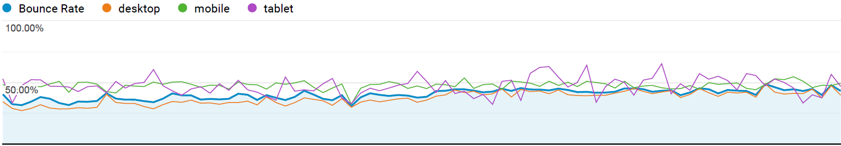
Hypothesis 4
Devices are not related to Bounce Rate.
Why? → This metric can help us identify scaling and compatibility issues with different screen sizes and operating system versions.

Slide 24
Proposal Hypothesis 4
Focus most of our advertising efforts on our desktop version for further improvement & scaling, while we invest technical resources to fix tablet & mobile issues.
The difference was checked to be significant regarding Desktop/mobile & Desktop/tablet, but not significant regarding mobile/tablet.
Tablet bounce rate is by far the largest.
Results / Proposals

Slide 25

THANK YOU

